Slide 1
GenAI and Retrieval Augmented Generation -RAG

Slide 2
What is GenAI
Generative AI (genAI) is a broad label describing any type of artificial intelligence (AI) that can produce new text, images, video, or audio clips.
Technically, this type of AI learns patterns from training data and generates new, unique outputs with the same statistical properties.
These are deep neural networks trained with many layers on vast amount of data.

Slide 3
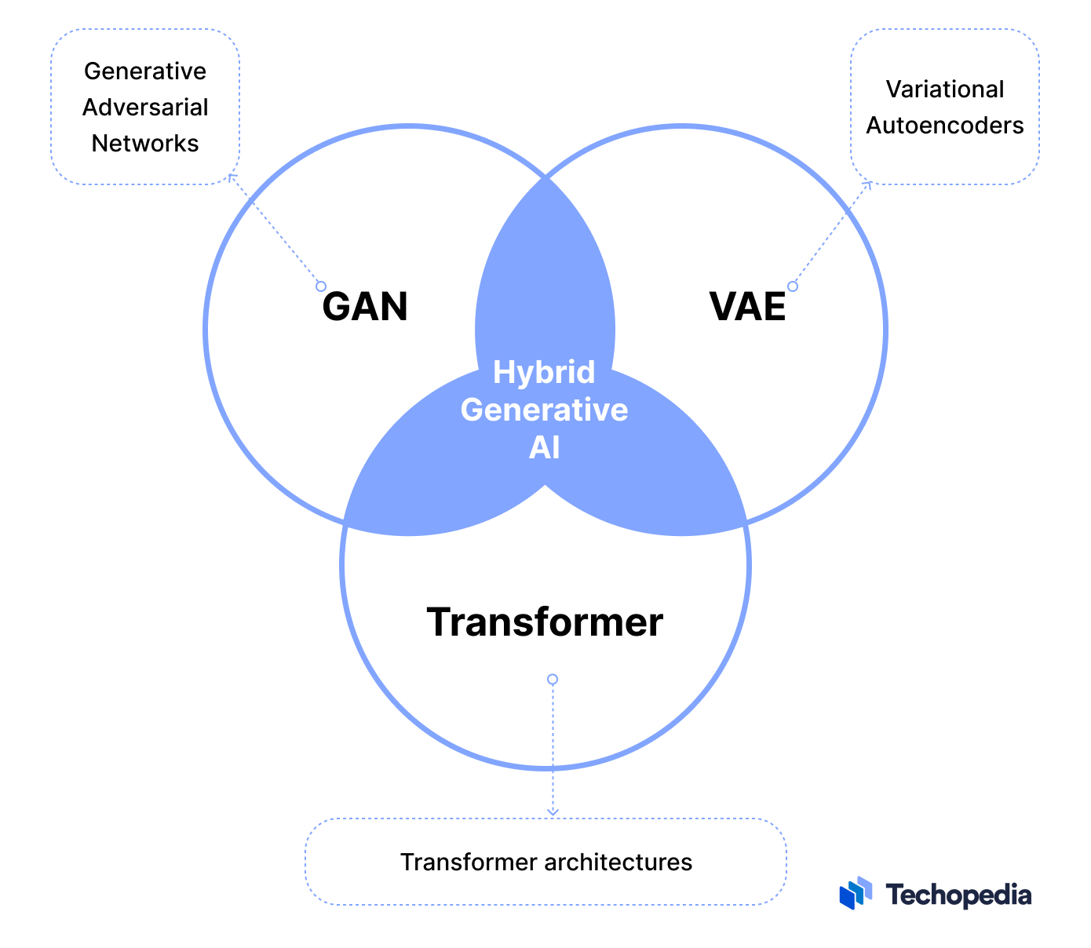
Types of GenAI
Generative Adversarial Networks (GANs): Consists of two networks generator and discriminator.
Variable Auto Encoder(VAE): Consists of an encoder and a decoder. The encoder takes input data and compresses it into a latent space representation that preserves its most important features
Transformers: consist of multiple stacked layers, each containing its own self-attention mechanism and feed-forward network. The task of this network is to guess the next word in the sequence.

Slide 4
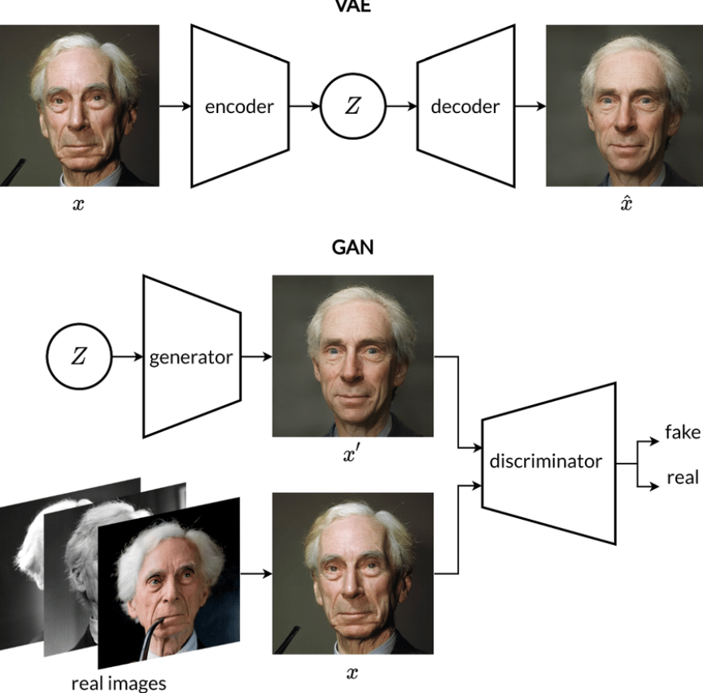
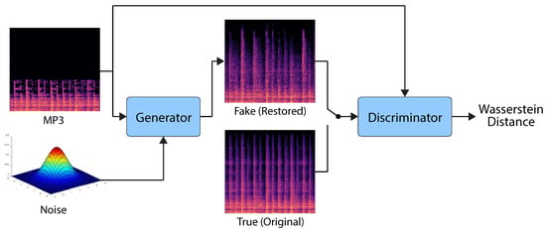
GAN and VAE

Slide 5
What are LLMs
A large language model (LLM) is a type of artificial intelligence (AI) program that can recognize and generate text, among other tasks. LLMs are trained on huge sets of data — hence the name "large.“
LLMs are built on machine learning: specifically, a type of neural network called a transformer model.
Eg: Chatgpt, Llama2 , Mistral etc.

Slide 6
How are LLMs used
Automate routine tasks
Improve decision making
Boost creativity and innovation
Language translation
Customer support
Content creation
Audio/Video analysis

Slide 7
What is RAG
RAG stands for Retrieval-Augmented Generation
RAG combines retrieval and generation processes to enhance the capabilities of LLMs
In RAG, the model retrieves relevant information from a knowledge base or external sources
This retrieved information is then augmented with user query used in conjunction with the model's internal knowledge to generate coherent and contextually relevant responses

Slide 8




Retrieval-Augmented Generation (RAG) Architecture
2. Convert Query to Vectors for easy Search
RAG Arch : Response Retrieval Pipeline
User Query
Query Vector Embeddings
Relevant Document Chunk
Prompt
(User Query and Relevant Chunks)
What are some on the MAC control elements
0.009
0.003
-0.04
0.009
0.003
-0.04
Similarity Search
3. Identify information related to the query to prepare Response
Embedding Model
Vector Store
1. Convert Text to Vectors for easy Search
LLM
4. Pass chunks relevant to query to LLM and get a response
Pipeline for Data Preparation and Info Extraction
Raw Data Sources
Chunks of data
Data Vector Embeddings
chunk
chunk
0.009
0.003
-0.04
0.005
0.009
0.003
-0.04
0.005
chunk
chunk
Thanks for Asking. Some of the MAC control elements:
1) CRNTI
2) BSR (Buffer Status Report)
3) PHR (Power Headroom Report)
Source:/Docdatabase/OrgUnit/TSS 3.0/1
Response

Slide 9
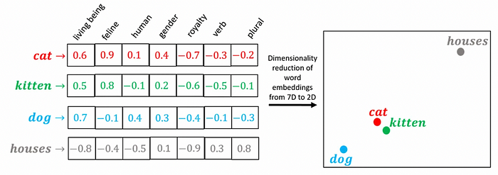
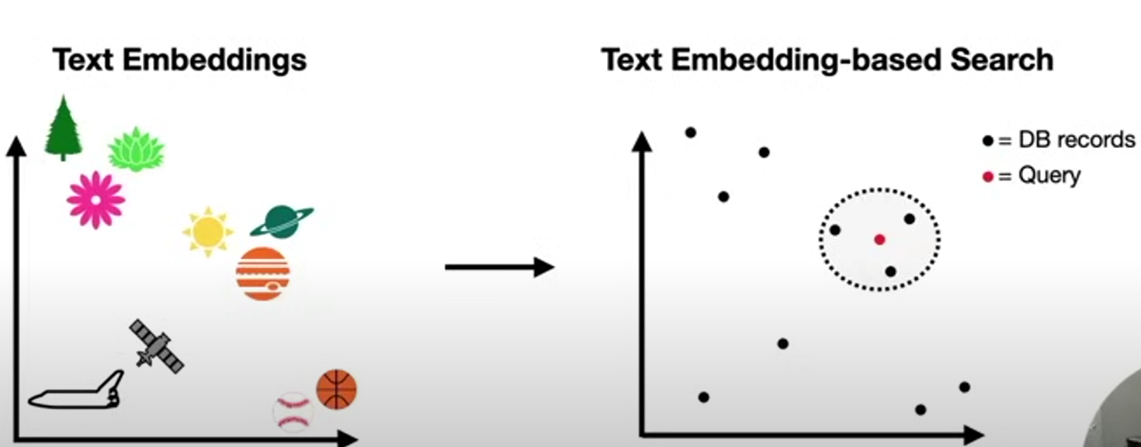
RAG Components
External data
The new data outside of the LLM's original training data set is called external data.
It can come from multiple data sources, such as a APIs, databases, or document repositories.
The data may exist in various formats like pdf files, database records, or long-form text.
Data Chunking:
Before the retrieval model can search through the data, it's typically divided into manageable "chunks" or segments
Vector embeddings
ML models cannot interpret information intelligibly in their raw format and require numerical data as input. They use neural network embeddings to convert real-word information into numerical representations called vectors.
Vectors are numerical values that represent information in a multi-dimensional space

Slide 10
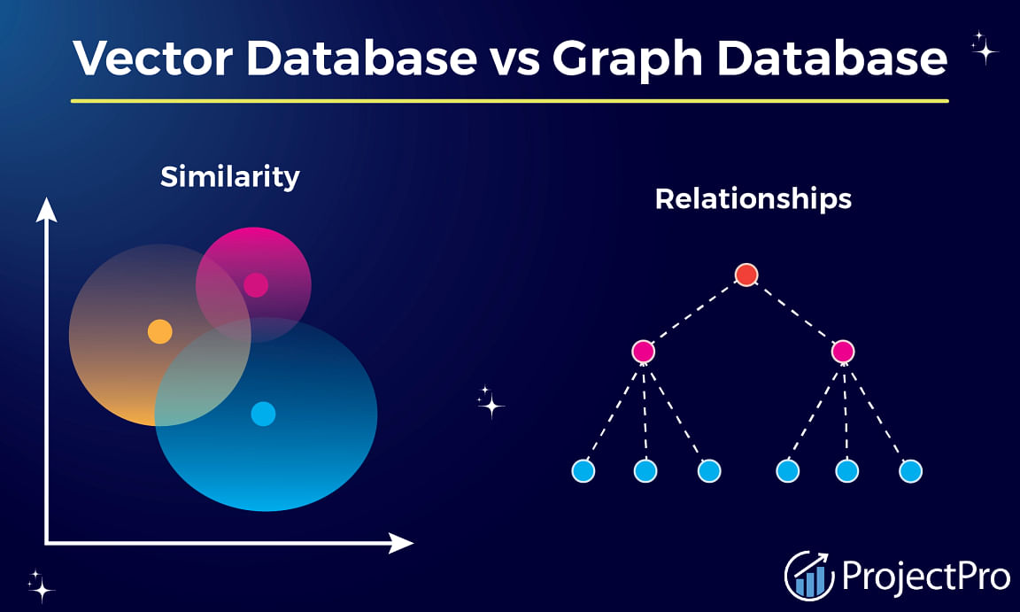
Knowledge base
RAG Components
Vector DB
Vector DB is a database that stores embeddings of words, phrases, or documents along with their corresponding identifiers.
It allows for fast and scalable retrieval of similar items based on their vector representations.
Vector DB Examples : Chroma, Pinecone, Weaviate, Elasticsearch
Knowledge graph (KG)
Employ graph structures for data storage and querying, enabling efficient navigation through relationships.
Focus on representing and structuring relationships between entities.
KG examples:GoogleKnowledgeGraph,DBPedia ,Wikidata
Vector databases excel at managing high-dimensional data and conducting similarity searches, while Graph databases are good at managing intricate relationships between entities.

Slide 11
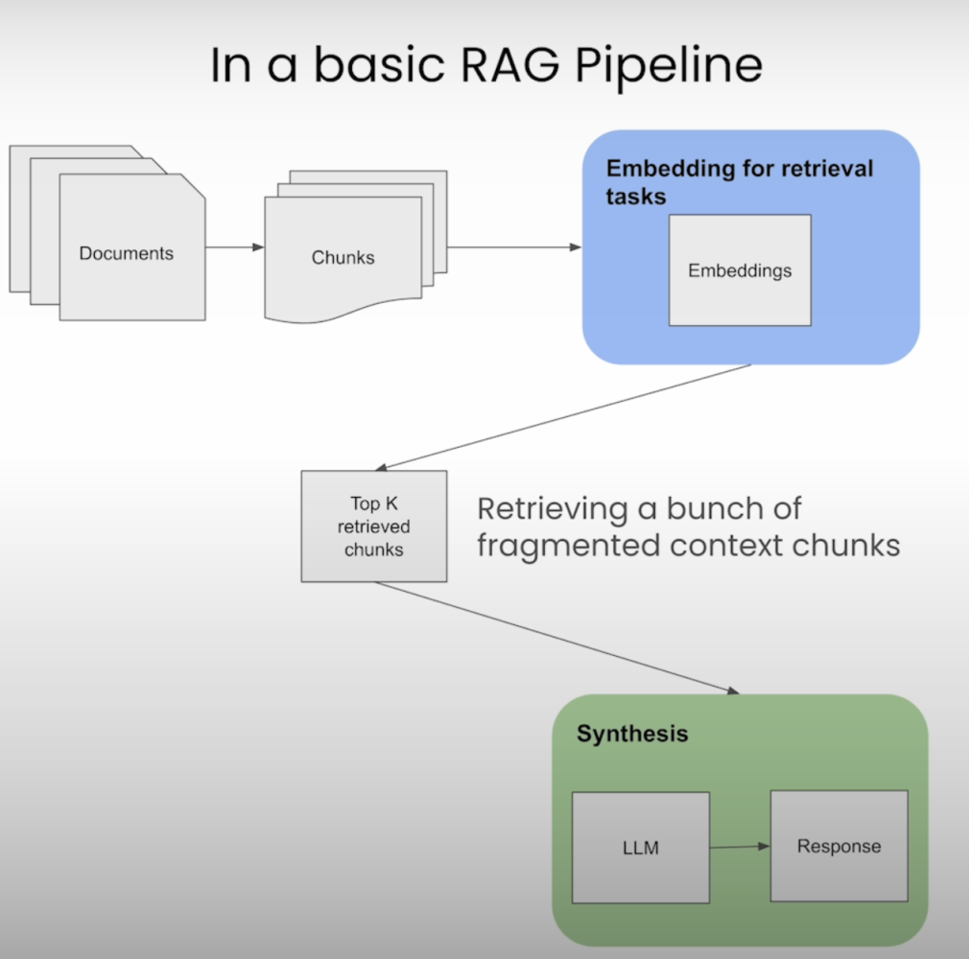
RAG Components
RAG Retriever
The next step is to perform a relevancy search. The user query is converted to a vector representation and matched with the vector databases or knowledge graph
The retriever component is responsible for efficiently identifying and extracting relevant information from a vast amount of data
Retrieval Techniques
sentence window
Retrieves window of sentences around the most relevant sentence, rather than just the sentence itself
auto-merging
Dynamically generates more coherent or ordered text chunks than simpler retrieval methods.
RAG Ranker
The RAG ranker component refines the retrieved information by assessing its relevance and importance. It assigns scores or ranks to the retrieved data points, helping prioritize the most relevant ones.

Slide 12
RAG Components
Augment the LLM prompt
Next, the RAG model augments the user input (or prompts) by adding the relevant retrieved data in context. This step uses prompt engineering techniques to communicate effectively with the LLM.
The augmented prompt allows the large language models to generate an accurate answer to user queries.
RAG Generator
The RAG generator component is basically the LLM Model such a (GPT)
The RAG generator component is responsible for taking the retrieved and ranked information, along with the user's original query, and generating the final response or output.
The generator ensures that the response aligns with the user's query and incorporates the factual knowledge retrieved from external sources.

Slide 13
RAG Evaluation
Currently, determining the right evaluation metrics and collecting good validation data is an active research field. As this is a quickly evolving topic, we are currently witnessing the appearance of various approaches for RAG evaluation frameworks, such as the
RAG Triad of metrics
RAGAs Score

Slide 14
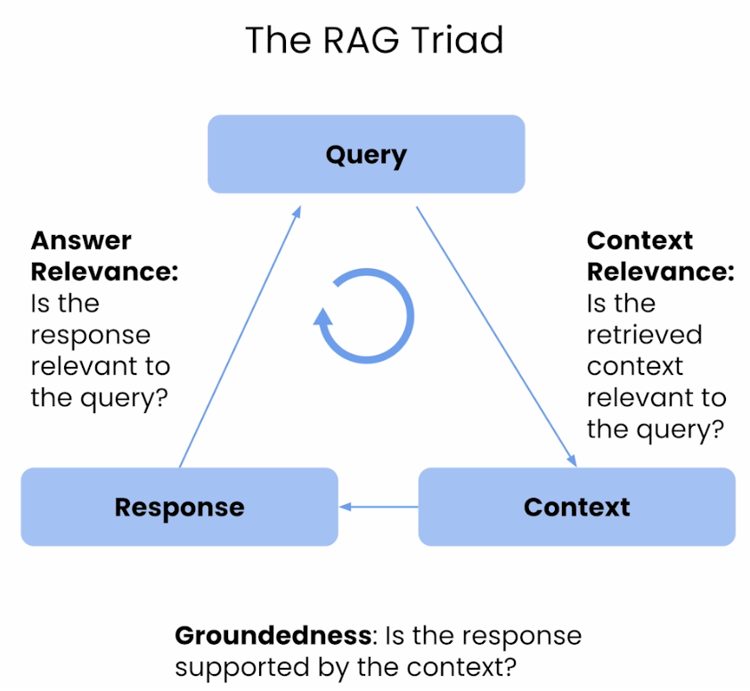
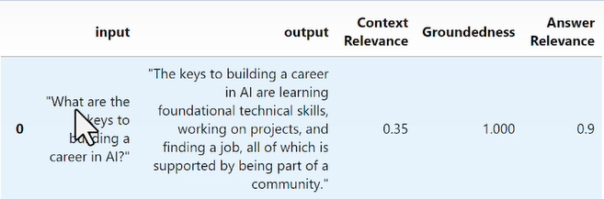
RAG Evaluation
Evaluating the retrieval component of RAG in the context of LLMs involves assessing how effectively the system retrieves relevant information to support the generation of accurate ,reliable and contextually appropriate responses.
These evaluations help detect hallucinations in LLM responses by ensuring that context is relevant, responses are grounded, and answers align with user queries.
Evaluation metrics respond only as a number from 0 to 1 where 0 is the least relevant and 1 is the most relevant
Tools :TruLens

Slide 15
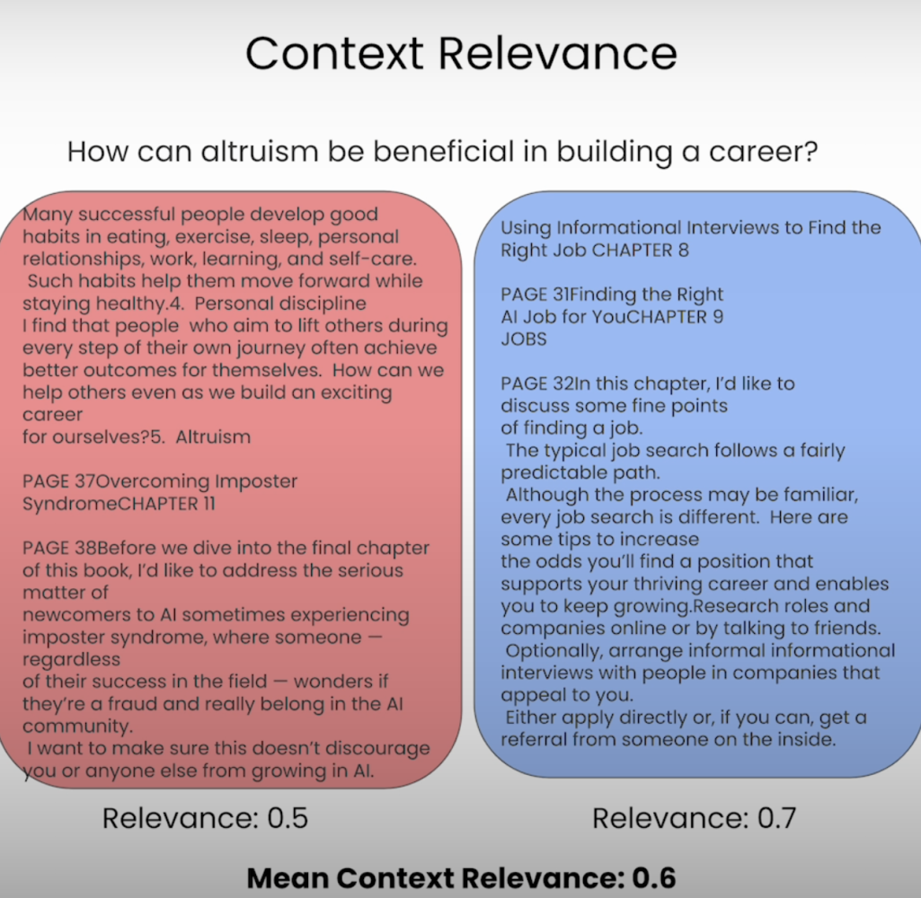
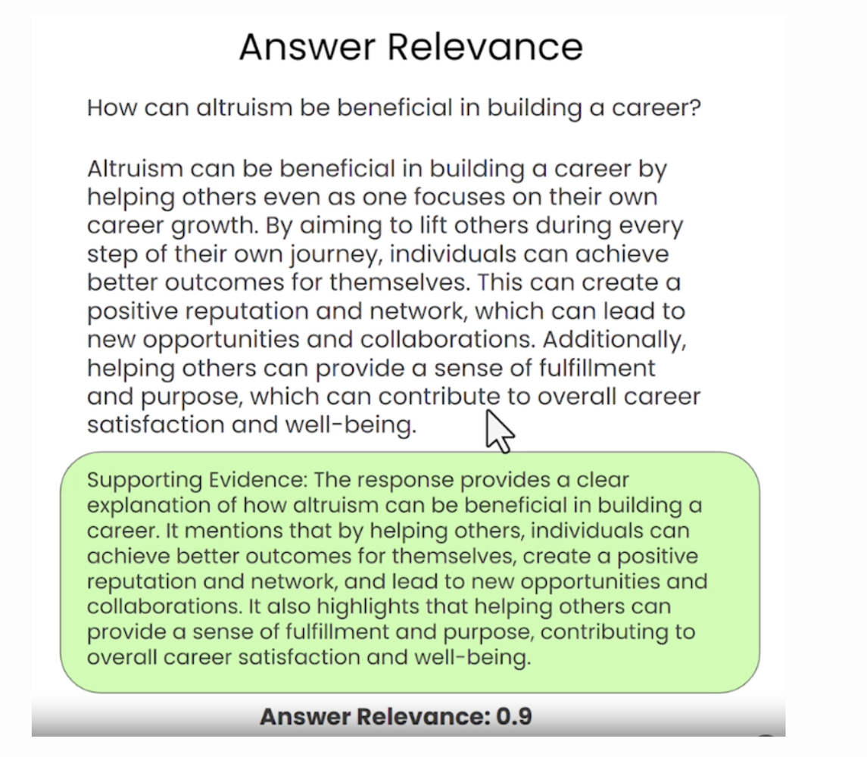
RAG TRIAD Evaluation Metrics example

Slide 16
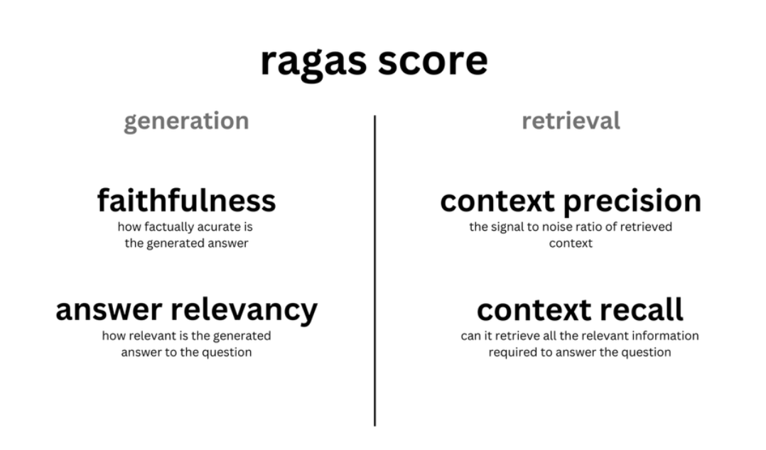
RAG Evaluation
Ragas metrics to evaluate retrieval: offers context relevancy and context recall which give you the measure of the performance of your retrieval system.
Ragas metrics to evaluate generation: offers faithfulness which measures hallucinations and answer relevancy which measures how to the point the answers are to the question.
The harmonic mean of these 4 aspects gives you the ragas score which is a single measure of the performance of your QA system across all the important aspects.
Evaluation metrics respond only as a number from 0 to 1 where 0 is the least relevant and 1 is the most relevant
Tools :Ragas

Slide 17
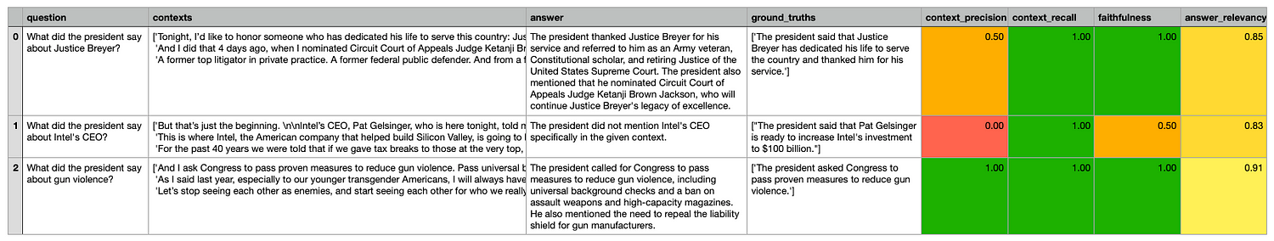
RAG Evaluation

Slide 18
RAG Example
https://medium.aiplanet.com/evaluate-rag-pipeline-using-ragas-fbdd8dd466c1
https://www.trulens.org/trulens_eval/getting_started/quickstarts/langchain_quickstart/#retrieve-records-and-feedback
https://www.trulens.org/trulens_eval/getting_started/quickstarts/llama_index_quickstart/

Slide 19
RAG Benefits
Enhanced Relevance: Incorporates external knowledge for more contextually relevant responses.
Improved Quality: Enhances the quality and accuracy of generated output.
Versatility: Adaptable to various tasks and domains without task-specific fine-tuning.
Efficient Retrieval: Leverages existing knowledge bases, reducing the need for large labeled datasets.
Dynamic Updates: Allows for real-time or periodic updates to maintain current information.
Trust and Transparency: Accurate and reliable responses, underpinned by current and authoritative data, significantly enhance user trust in AI-driven applications.
Customization and Control: Organizations can tailor the external sources RAG draws from, allowing control over the type and scope of information integrated into the model’s responses
Cost Effective

Slide 20
RAG Open-source tools
LangChain: LangChain is a versatile Python library that simplifies the development of applications involving large language models, including RAG implementations. It provides a modular and extensible architecture, allowing developers to easily integrate different components, such as retrieval systems, knowledge bases, and generation models.
LlamaIndex: Developed by Anthropic, LlamaIndex is a Python library that facilitates the creation of RAG systems. It offers a user-friendly interface for indexing and querying various data sources, making it easier to integrate external knowledge into language models.
RAG on Hugging Face Transformers: Hugging Face, a leading provider of open-source natural language processing (NLP) tools, has integrated RAG functionality into their Transformers library. This integration allows developers to leverage pre-trained language models and combine them with retrieval systems, enabling the creation of RAG models with minimal effort.
REALM Library: Developed by Google AI, the REALM (Retrieval-Enhanced Language Model) library provides a framework for building and evaluating RAG models. It offers a modular design, allowing researchers and developers to experiment with different retrieval and generation components, as well as various knowledge sources.
NVIDIA NeMo Guardrails: NVIDIA’s NeMo Guardrails is a toolkit designed to enhance the safety and reliability of language models. It includes RAG capabilities, enabling developers to incorporate external knowledge sources into their models, improving the accuracy and trustworthiness of generated outputs.

Slide 21
THANK YOU

